Slide 1
Promotion Policy Presentation
District 4
Thursday January 18, 2024

Slide 2

Agenda
Introduction to Promotion Policy
Promotion Timeline
Promotion Criteria
Modified Promotion

Slide 3
Introduction to Promotion
The NYCPS ’s promotion process ensures that students receive the support they need to succeed in the next grade level. For grades Kindergarten through 8, schools review many pieces of student work to determine if students are ready for the next grade level. For grades 9 through 12, schools make promotion decisions based on course credits.

Slide 4
January – Early February:
Promotion in Doubt
Schools identify students who are not on track to meeting promotion benchmarks at the end of the school year.
Families of students whose promotion is in doubt receive an email or written notice in the mail.

Slide 5
Schools do promotion portfolios for students who may not be ready for the next grade level
  This is based on student work and assessments from throughout the school year.
  Principals make promotion decisions based on the English language arts and math skills shown in the student’s portfolio.
  Students in grade 8 must also pass the following courses in order to be promoted:
    English
    Math
    Social studies
    Science
Families of students who are not promoted are notified by their schools. Students are required to attend Summer School.
D4 Promotion Presentation

Slide 6


August- Summer Promotion
At the end of summer, principals make final promotion decisions based on students’ portfolios and summer work.
Families of students not promoted in June are notified.
Families may appeal promotion decisions by submitting a written appeal to their student's principal.
D4 Promotion Presentation

Slide 7
Promotion decisions are made by each school principal based on multiple measures of student readiness for the next grade level in English and math (as well as science and social studies for grade 8 students).
Teachers review student work from the school year to identify students who may not be ready for the work of the next grade in English language arts and/or math, even with support. Students whose work shows they are ready for the next grade are promoted by the principal in June.
If a student's work shows they may not be ready for the next grade level, the teacher completes and scores the portfolio. The principal makes the promotion decision based on the portfolio results.
If your student is not promoted in June based on their portfolio results, your student is required to participate in summer learning. At the end of summer, the school reviews the progress of the student, and the principal makes the final promotion decision.
D4 Promotion Presentation

Slide 8
Promotion Criteria
Students may have different promotion criteria based on their grade level, criteria specified on their Individualized Education Programs (IEPs), and/or English language learner (ELL) status.

Slide 9
K-2 and Standard Promotion Criteria
Students in Kindergarten–Grade 2 Schools must notify a student’s family in the Spring if promotion is considered not to be in the child’s best interest and actively involve the family in reaching a decision to retain the student.
Students in Grades 3‒8 Are held to Standard Promotion Criteria (including a majority of students with IEPs and ELLs).

Slide 10
Students with IEPs in Grades 3‒8 Held to Modified Promotion Criteria
There are some students with disabilities in grades 3–8 whose rate of progress and impact of disability are so severe that they are unable to meet their school’s promotion benchmarks even when they are provided with appropriate special education accommodations, supports and services and specially designed instruction. These students may be held to modified promotion criteria in ELA and/or math. Students with modified promotion criteria are held to the ELA and math criteria specified in their IEP at the time the promotion decision is being made. Students in grade 8 also must pass all four-core courses (ELA, Math, Science, and Social Studies) to be promoted to grade 9.

Slide 11
English Language Learners in Grades 3‒8
Students in grades 3–7 who are ELLs and have been enrolled in a USSS for at least two years, but fewer than six years, or who are Students with Interrupted Formal Education (SIFE)
Students must demonstrate sufficient progress in English as a New Language (ENL) literacy development in alignment with learning standards for ELA as evidenced by multiple measures.
Students must demonstrate sufficient progress toward attaining learning standards for math taught either in the student’s native language or using ENL methodologies; or attain sufficient progress in math taught using ENL methodologies as evidenced by student work.

Slide 12
English Language Learners in Grades 3‒8
Students in grade 8 who are ELLs and have been enrolled in a USSS for at least one year but fewer than two years, or who are Students with Interrupted Formal Education (SIFE) o Students must demonstrate sufficient progress in ENL literacy development in alignment with learning standards for ELA as evidenced by multiple measures. o Students must demonstrate sufficient progress toward attaining learning standards in math, as evidenced by student work

Slide 13
English Language Learners in Grades 3‒8
Students in grade 8 who are ELLs and have been enrolled in an USSS for at least two years but fewer than four years o Students must achieve expected gains on either the NYSESLAT or the DOE-issued ELL periodic assessments, or demonstrate sufficient progress toward attaining ELA learning standards. o Students must demonstrate sufficient progress toward attaining math learning standards, as evidenced by student work.

Slide 14
How do schools determine which students get promotion portfolios?
Schools prepare promotion portfolios for students whose work shows that they may not be ready for the next grade. This can be based on report card grades, student writing samples, projects, assessments, assignments, and other work chosen by the school.
Schools do not prepare portfolios for students who show they are prepared for the next grade based on their work throughout the school year. The principal promotes these students in June.

Slide 15
What can I do if I am not satisfied with the final promotion decision for my student?
If you are not satisfied with the final promotion decision, you may contact the principal of your student's school appealing the decision at the end of August. The appeal will be reviewed by the superintendent, who makes the final decision.

Slide 16
What if my student cannot participate in summer learning?
Summer learning is an opportunity for students to develop the skills and knowledge needed for the next grade level. At the end of the summer, schools complete a review of students’ portfolios with their summer work and assessments. If your student cannot attend summer learning, you may still submit a written appeal to the principal by the end of August but you may find it difficult to demonstrate that your student is prepared for the next grade level.

Slide 17
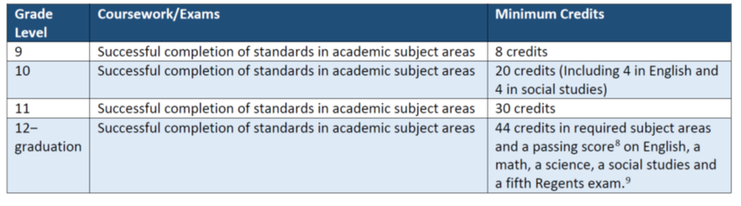
High School Promotion

Slide 18
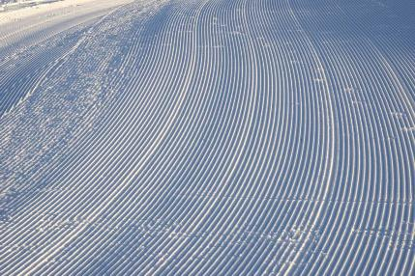


Summary
Promotion is the process by which teachers determine if students have learned enough content and skills to be successful in the next grade level. Students may have different promotion criteria based on their grade level, criteria specified on their Individualized Education Programs (IEPs), and/or English language learner (ELL) status. Schools must choose their promotion benchmarks, which are the specific academic standards all students must meet to be promoted to the next grade level at the end of the school year. Students are then assessed on their progress towards these benchmarks, using multiple measures that schools also choose, to ensure that they have many opportunities to demonstrate their knowledge and abilities.

Slide 19
Thank you

